Slide 1
Corporate Update
Adiel A. Akplogan
CEO, AFRINIC
28 November 2012

Slide 2
AFRINIC at glance
34 full time Staff at work
112 New Members (15% growth)
17 training sessions in 2012 500 people
trained new IPv6 allocations/Assignments in 2011
More than 260 total travels handled to participate to more than 30 events around the world.
A balanced Budget of USD 2,7 M
All of this is now supported by our new Organisation Structure
Complete the review of Bylaw Process

Slide 3
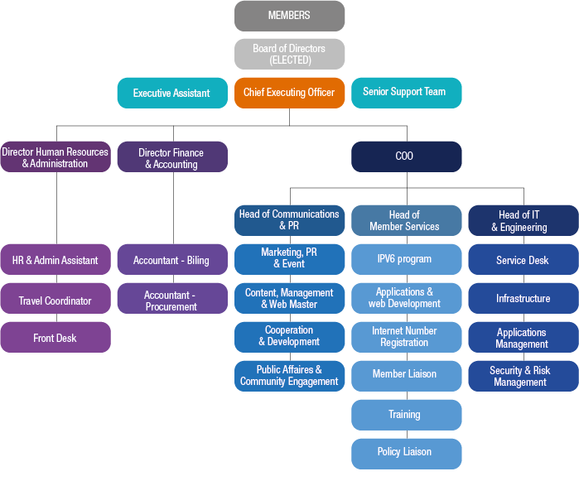
New Structure

Slide 4
From 2011 to 2012
Finalise AFRINIC 2.0
Implement New Structure – ✔
Finalise new Bylaws – ✔
Rebranding - ✔
Strategic Plan 2013-2015 – ✔➔
Improve Contribution to Public Infrastructure in Africa. ✔➔
Improve Support to Governments & Policy Makers on IG and related issues. ✔➔
Quality assurance (process and Services) – ✔➔

Slide 5
Where are we going?
Our strategic goal and objective is to build an organization that will last and continue to serve the community:
Continue to strengthen our critical role for Number Resources Management and Internet Infrastructure development.
Continue to Increase our productivity, our financial stability to better serve the community.
Continue to adjust our structure and services to our changing ecosystem

Slide 6
Key Operations Areas
Relevance
Efficiency
Capacity
Effective Registration Service
Community Development
Core Infrastructure Stability
Global Infrastructure Stability

Slide 7
Bylaw review

Slide 8
Highlight of New Bylaws
Reduce Board size from 13 to 9 with three non-regionals
Membership Types
Registered Members (Board)
Resources Members (LIR/End-Users)
Associate Members (Others)
Introduction of a formal General Member Meeting once a year
Separate Nomination committee from Election Committee
Formalisation of CoE in the Bylaws
Introduce: e-voting and emergency Policy decision mechanism

Slide 9
Questions

