Slide 1
WHOIS UPDATES

Slide 2
Three Main Updates
DNSSEC Deployment
Full support for ASPLAIN
Abuse Contact Implementation
Notes:
As mentioned by Alain, afrinic has deployed DNSSEC.
Will talk about the Implications on our WHOIS, which previously did not support DNSSEC.
Will talk about full support for ASPLAIN, as per policy [AFPUB-2005-ASN-001 ]
Lastly will talk about implementation of abuse contact as per policy [AFPUB-2010-GEN-006]
We have chosen to use the mnt-irt object

Slide 3
DNSSEC

Slide 4
DNSSEC
One part of DNSSEC deployment plan
Minor change in WHOIS
ds-rdata attribute
Two methods for updating this field
Via MyAfrinic (with verification)
auto-dbm@afrinic.net (without verification)
Notes:
- Part of the DNSSEC deployment plan consists of accepting ds records form members, that are required to sign their reverse delegation.
- It required a minor change in the way our WHOIS stores a Domain object, which is the addition of the ds-rdata attribute.
- Afrinic provides two means of updating their domain objects and adding their DS records.
- Either on myafirnic or via auto-dbm@afrinic.net , i.e sending a mail with your object to auto-dbm@afrinic.net
On myafrinic, we perform all those verifications mentioned by Alain before updating your domain object,
whereas via auto-dbm, the verifications have not yet been implemented. So if you want to make sure that your have a correct ds record, use myafrinic

Slide 5
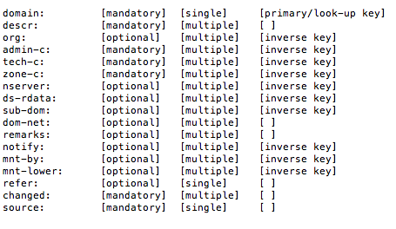
DNSSEC
Domain Object template
Notes:
Here is a domain object template.
We can see the ds-rdata attribute
Notice the optional attribute , multiple up to 8 , inverse lookup key meaning we can do a whois search for the domain using the ds-rdata

Slide 6
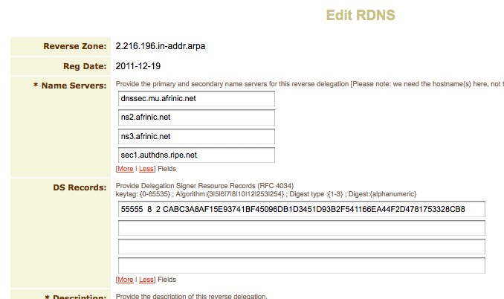
DNSSEC
Reverse Delegation on MyAFRINIC
Notes:
On myafrinic, the edit domain interface looks like this now, notice the fields allowing you to specify your ds records.

Slide 7
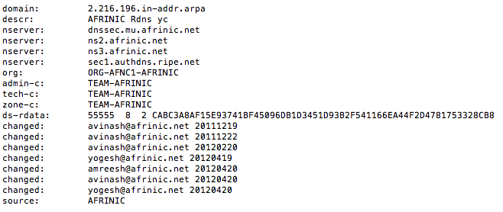
DNSSEC
Example of Domain object on WHOIS
Notes:
Example of a Domain object as it appears on whois.
Notice the ds-rdata attribute

Slide 8
ASPLAIN

Slide 9
ASPLAIN
Full Support for 4-Byte ASN
Scrap out the dot format
<high order 16 bit value in decimal>.<low order 16 bit value in decimal>
4-byte AS Number of value 65546 (decimal) would be identified as "1.10”
Both WHOIS and Myafrinic support this format
Notes:
Afrinic now provides full support for 4-byte ASN, which we call ASPLAIN
In decimal format only digits, unlike previously the dot format .
search for asn in dot format wont return anything.
Myafrinic as well is in line with this modification.
Eg: AS327681 instead of AS5.1

Slide 10
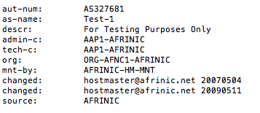
ASPLAIN
Example of previously AS5.1 in plain format
Notes:
An example of an aut-num that was previously identified by AS5.1, it is now represented as AS327681

Slide 11
Abuse contact Policy

Slide 12
Abuse Contact Policy
AFPUB-2010-GEN-006
Recommendations:
For abuse reports to reach the correct network contact
Create a new or uses an already existing object
A unique reference by inetnum, inet6num and aut-num
Contains 2 email attributes:
"e-mail:" for personal communication
"abuse-mailbox:" for automatic report handling

Slide 13
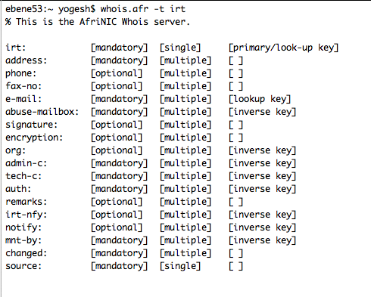
Abuse Contact Policy
- Use existing Incident Response Team Object
Notes:
Was previously not used.
Object ID must start with "IRT-" or "irt-".

Slide 14
Abuse Contact Policy
IRT Object
Field: abuse-mailbox
Abuse Contact email address
Mandatory
Multiple
whois -i abuse-mailbox <email>
Field: email
Abuse Contact email address
Mandatory
Multiple
Notes:
This field is [mandatory] and [multiple]
This field is inverse searchable using the flag:
"whois -i abuse-mailbox <email>"
Not to be confused with the email field, which is also
mandatory but is filtered out in the default query output.

Slide 15
Abuse Contact Policy
IRT Object
Field: auth
Authentication credentials
Password or PGP Key
Used when adding or removing a reference to inetnum, inet6num or aut-num objects
Mandatory
Multiple
whois -i auth <email>
Notes:
This field is [mandatory] and [multiple]
The additional authentication to use only when adding or removing a reference to the irt object

Slide 16
Abuse Contact Policy
IRT Object
Field: irt-nfy
Notify email address
Optional
Multiple
whois -i irt-nfy <email>
Notes:
This field is [optional] and [multiple]
This email address will be notified whenever this IRT object is added to an INETNUM, INET6NUM or AUT-NUM object.
Not to be confused with the notify attribute.
This one is used when the object is referenced or dereferenced, whereas the notify attribute Is when the object itself is modified

Slide 17
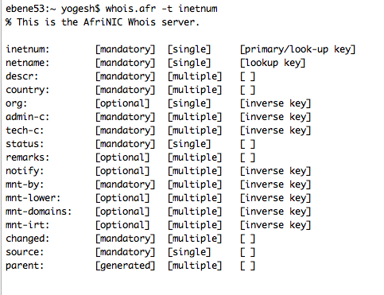
Abuse Contact Policy
]
Notes:
This field is [optional] and [multiple]
This email address will be notified whenever this IRT object is added to an INETNUM, INET6NUM or AUT-NUM object.
To circle the inetnum line and mnt-irt line

Slide 18
Abuse Contact Policy
INETNUM Object
Field: mnt-irt
Reference an IRT object
Optional
Multiple
whois -i mnt-irt <IRT ID>
Similarly in INET6NUM and AUT-NUM
Notes:
This field is [optional] and [multiple]
This email address will be notified whenever this IRT object is added to an INETNUM, INET6NUM or AUT-NUM object.

Slide 19
Abuse Contact Policy
Referencing an IRT Object
IRT
OBJECT
INETNUM referencing an IRT Object
INETNUM’s maintainer authentication AND
IRT object’s authentication
(Password / PGP Key)
INETNUM
OBJECT
Notes:
This diagram depict how we can reference an IRT object to an INETNUM.
First we have to have our irt object and inetnum objects already created.
When referencing the IRT, we need the authentication for the IRT object, as well as the authentication of the inetnum object’s maintainer.
We are done, now abuse emails for this inetnum object will be sent to the IRT’s aduse-email.

Slide 20
WAY FORWARD

Slide 21
- we are closely following the WEIRDS mailing list
- dev-team is looking into technologies to build RESTFUL services around whois

Slide 22
THANK YOU
AFRINIC DEV-TEAM

