Slide 1
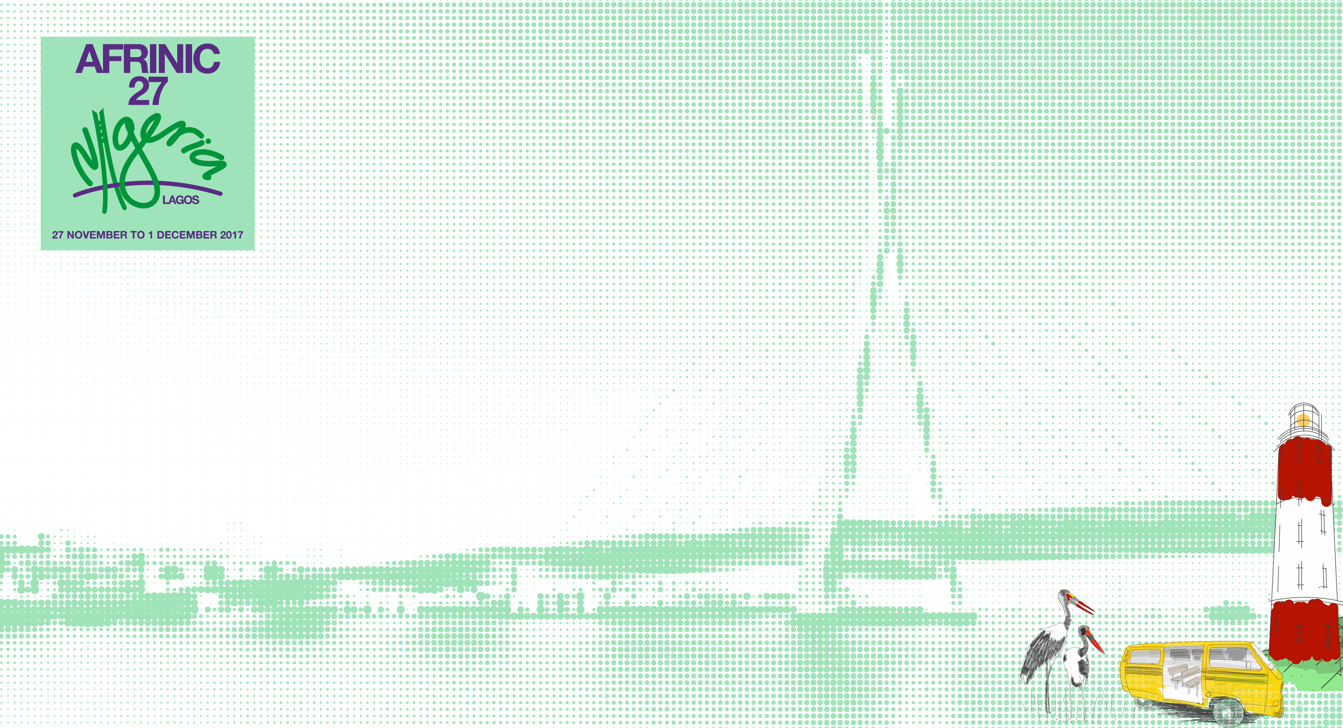
PRESENTATION TITLE []
AUTHOR NAME
NOVEMBER 2017

Slide 2
Title and Content
Into the center of excellence, Lagos!!

Slide 3
Two Content
Did you know that if Lagos were to be a country, it would be the fifth largest economy in Africa!
With a GDP pegged at $90 billion; that’s bigger than the economies of Ivory Coast and Kenya!

Slide 4
Comparison
Abuja
Lagos
Administrative capital and in the very heart of Nigeria
Financial Capital and port city. Everything gets to Lagos before the rest of Nigeria!

Slide 5
Blank Slide.
Yankari game reserve is located in Bauchi, a north-eastern state in Nigeria. It covers a land size of 2,250 Square kilometers. That’s twice the size of Mauritius!! Sadly the West African Lion that calls this place home, is under the threat of extinction

