Slide 1
Internet Exchange Point
What is it? Do We “Really” Need it?
Presenter
Sami H. O. Salih
National Telecom. Corporation
President of SDv6TF

Slide 2
بسم الله الرحمن الرحيم
“قَالَ الَّذِي عِنْدَهُ عِلْمٌ مِنَ الْكِتَابِ أَنَا آَتِيكَ بِهِ قَبْلَ أَنْ يَرْتَدَّ إِلَيْكَ طَرْفُك ”
“One with whom was knowledge of the Scripture said: I will bring it thee before thy gaze returneth unto thee. And when he saw it set in his presence, (Solomon) said: This is of the bounty of my Lord, that He may try me whether I give thanks or am ungrateful. Whosoever giveth thanks he only giveth thanks for (the good of) his own soul; and whosoever is ungrateful (is ungrateful only to his own soul's hurt). For lo! my Lord is Absolute in independence, Bountiful.”
صدق الله العظيم
الآية 40 سورة النمل

Slide 3
Content
IXP Development Milestones
The Problem
Configuration & Setup
Challenges
Africa’s Need
The Continent Problem
African IXP Map
Our Challenges
Brainstorming
The new Vision
IXP in Pool
The Way Forward

Slide 4
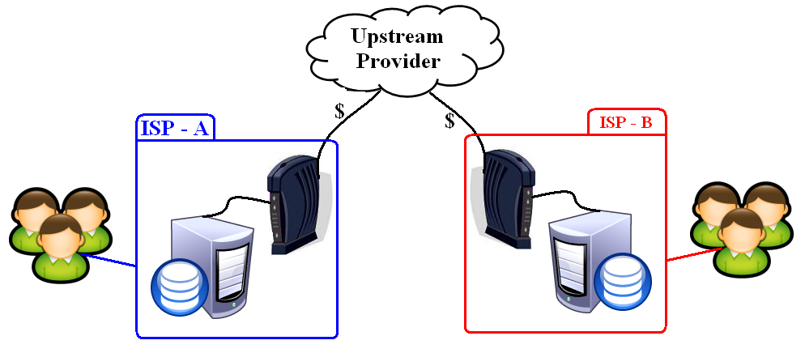
The Problem
Dispels the utilization of the high cost International Bandwidth when international circuits to exchange domestic traffic.

Slide 5
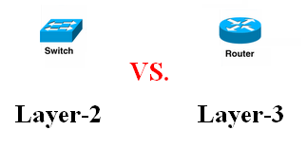
Configuration
A typical Internet Exchange Point (IXP) consists of routing equipment belonging to the participants, plus a central switch to which all of the routers are connected. Each network operator installs a connection to the IXP and exchanges traffic with other networks through the central switch.

Slide 6
Setup
When ISPs are terminated at the IXP they effectively peering directly with each other (“multilateral peering”). Thus, there is no need to set up individual peering sessions or agreements with every other ISP (“bilateral peering”).

Slide 7
Challenges
“Getting IXPs off the ground is 90 per cent socio-political engineering”
Brian Longwe
General Manager of AfrISPA
at the First Southern African Internet Forum, September 2002.

Slide 8
Content
IXP Development Milestones
The Problem
Challenges
Configuration & Setup
Africa’s Need
The Continent Problem
Our Challenges
African IXP Map
Brainstorming
The new Vision
IXP in Pool
The Way Forward

Slide 9
Our Problem

Slide 10
The Continent Challenges
The Need; Connectivity Issues
“At the moment, developing countries wishing to connect to the global Internet backbone must pay for the full costs of the international leased line to the country providing the hub. More than 90 per cent of international IP connectivity passes through North America. Once a leased line is established, traffic passes in both directions, benefiting the customers in the hub country as well as the developing country, though the costs are primarily borne by the latter. These higher costs are passed on to customers [in developing countries]. On the Internet, the net cash flow is from the developing South to the developed North.”
Yoshio Utsumi,
Secretary-General of ITU
New York, USA - 7 July 2000

Slide 11
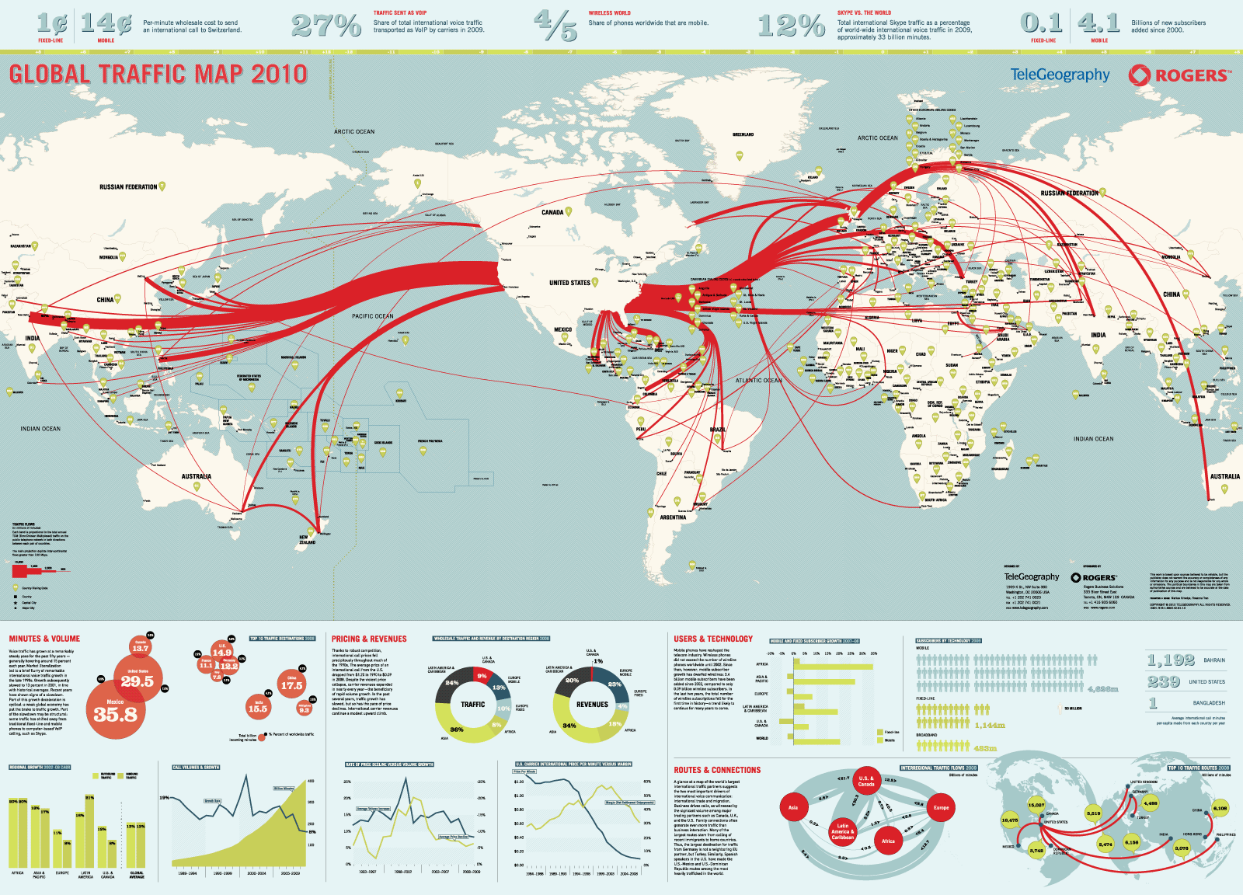
Global Traffic Map
From TeleGeography

Slide 12
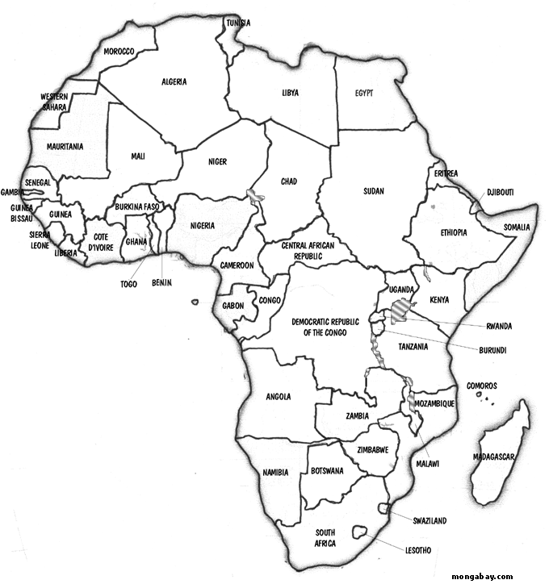
African IXP Map
At least one IXP known to exchange traffic
At least one IXP soon to exchange traffic
Thanks to;
Hisham Ibrahim - AfriNIC
Mauritius

Slide 13
Content
IXP Development Milestones
The Problem
Challenges
Configuration & Setup
Africa’s Need
The Continent Problem
Our Challenges
African IXP Map
Brainstorming
The new Vision
IXP in Pool
The Way Forward

Slide 14
The New Vision
Beyond the historical motto
“keep domestic traffic Local”
The challenge now is the
“Regional Connectivity”

Slide 15
IXP in Pool

Slide 16
Advantages of IXP Pool
Cost Savings
Increased Access Quality
Encourage Developing Local Service/Infrastructure
Connectivity
Root Server
Internet Services (email, timing)
Opportunities to Develop Local Contents
Streaming Video/Audio
Videoconferencing
Telemedicine
E-Commerce, Governance, Learning, etc

Slide 17
The Way Forward
Increase the data transition between Africans'
Connectivity;
Unified Operational Model;
Homogenous Manag. & Admin. Regime
Supervision Agency
and …….
Willing to Unity,

Slide 18
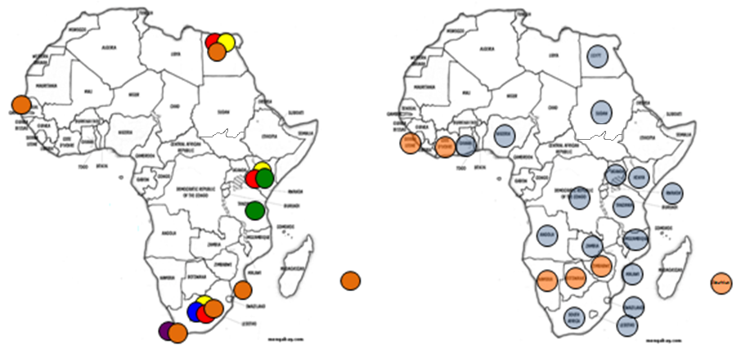
Root Servers VS. IXP

Slide 19
Regional Af-IXP

Slide 20
Recommendation
Participation of all ICT Stakeholders in the management of the IXP.
Negotiate to provide preferential rates to connect to the IXP.
Encourage Local Hosting.
Promote e-GOV applications.
Interconnect data warehouses to the IXP.
Develop local Service (VoIP, e-mail, etc).

