Slide 1
AFRINIC HUMAN RESOURCES PRESENTATION

Slide 2
Table of Contents
Organisational Structure and Recruitment
ISO
Performance Management System
Training Needs Analysis
Human Resources Management System
Communication process
Travel
Welfare

Slide 3
MOTIVATION
Organisational Effectiveness
Motivation
MOTIVATION
PERFORMANCE
Performance
Competencies
COMPETENCIES
Alignment with corporate objectives
DIRECTION

Slide 4
Human Resources Activities - Interrelationships
MOTIVATION
Organisational Effectiveness
Motivation
Environment
Strategic Plans
Corporate
Competencies
Alignment
Human Resources
Strategies
Organisation
Employee Sourcing
Employee Development
Reward Management
Employee Relations
Employee Services
Employment & Administration
Job/ Role Analysis
Human Resource Planning
Performance Management
Job Evaluation
Industrial Relations
Health & Safety
Employment Practices
Organisation Design
Recruitment & Selection
Training
Pay Systems
Involvement & Participation
Welfare
Information Systems
Job Design
Management Development
Paying for Performance
Communications
Organisational Effectiveness
Employee Benefits

Slide 5
ORGANISATIONAL STRUCTURE & RECRUITMENT

Slide 6
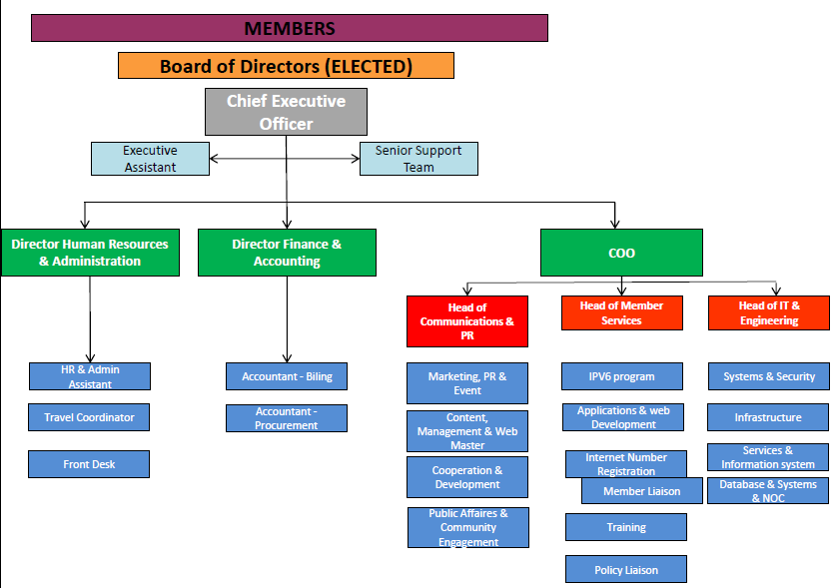
Organisational Structure & Recruitment
MOTIVATION

Slide 7
Organisational Structure & Recruitment
MOTIVATION
OBEJCTIVE: To ensure organisational effectiveness
Recruitment of top managers
Techniques used:
Personality Profile Testing
Panel Interviewing
Written Assignment

Slide 8
Organisational Structure & Recruitment
MOTIVATION
Recruitment of Heads of Department:
 | Name | Title | Date of joining
1. | N’GUESSAN Arthur | Head of Member Services | 21/02/12
2. | NYABUGA George | Head of Communications & PR | 23/04/12
3. | SOSSOU Neriah | Head of IT & Engineering | 23/04/12

Slide 9
Organisational Structure & Recruitment
MOTIVATION
Other Recruitments
 | Name | Title
1. | LARCHÉ Salveena | HR & Admin Assistant
2. | TAZIFOR Amin | Software Engineer
3. | KEERODHUR Avinash | Web Master
4. | PERRIER Emma | Receptionist/ Clerk
5. | SHAW Daniel | System Administrator

Slide 10
Organisational Structure & Recruitment
MOTIVATION
Recruitments to be completed during the year:
 | Name | Title
1. | Trainee for system Administration | (End of May 2012)
2. | Public Affairs and Community Engagement | (End of July)
3. | Cooperation and Development | (End of November 2012)
4. | Database Manager | (End of November 2012)

Slide 11
ISO 9001:2008 CERTIFICATION

Slide 12
ISO 9001:2008 Certification
MOTIVATION
How does ISO help in improving the services provided by the company?
Well defined and documented procedures
Improve the consistency of output.
Quality is constantly measured
Procedures ensure corrective action is taken whenever defects occur.
Defining procedures identifies current practices that are obsolete or inefficient.
Documented procedures are easier for new employees to follow.

Slide 13
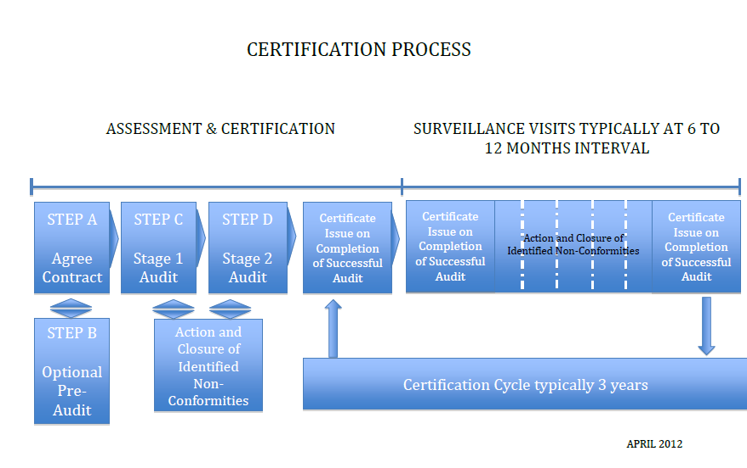

Slide 14
Time frame
Selection of the Awarding Body for ISO (DONE)
We chose SGS (Mauritius) Ltd for its professionalism and knowledge of the African context.
Training of Staff on ISO (MAY)
Selection of an ISO Audit Consultant for follow up (MAY)
Reviewing of existing Policies and procedures and Introduction of new Policies & Procedures
Preparing for the blank Audit
Final Audit for Award
7
6
5
4
3
2
1
MAR | APR | MAY | JUN | JUL | AUG | SEP | OCT | NOV | DEC

Slide 15
PERFORMANCE MANAGEMENT SYSTEM

Slide 16
Performance Management System
MOTIVATION
The objectives of the PMS are to:
Align the individual goals, departmental goals and organizational goals
Create transparency in achievement of goals
Help setting measurable goals
Provide well documented and communicated process documentation
Improve employee engagement because everyone understands how he is directly contributing to the organization's high level goals
Improve communication between boss and subordinate
Help individual development

Slide 17
Overview of Performance Management
MOTIVATION

Slide 18
PERFORMANCE MANAGEMENT SYSTEM
MOTIVATION
Key steps for the implementation:
Having clear Job Descriptions
Identifying the KRAs and KPIs for corporate, department and
individual
3. Measuring and following performance
Carrying our Performance Appraisal exercises
Identifying the performance gap
Setting up a Performance Development Plan
6
5
4
3
2
1
APRIL | MAY | JUNE | JULY | AUG | SEP | OCT | NOV | DEC

Slide 19
TRAINING NEEDS ANALYSIS

Slide 20
TRAINING NEEDS ANALYSIS
AIM: To identify the training gaps between expected performance and actual performance of the company, the departments and the individuals.
PERFORMANCE

Slide 21
TRAINING NEEDS ANALYSIS
TRAINING CYCLE
PERFORMANCE

Slide 22
MOTIVATION
STEPS:
TNA
1. Training Plan | Training Plan: Defining the main training areas for the 3 categories : Corporate, Department and Individual
2. Training Programme | Training Programme: Liaise with Training Institutions to identify courses to be followed.
3. Delivery of Training | As per above programme
4. Application & Evaluation of training | Reaction Learning Behaviour Results
MOTIVATION
COMPETENCIES
DIRECTION

Slide 23
Implementation of Training Needs
MOTIVATION
Meeting with CEO, HODs & individual employees
Meeting with Training Institutions to find adequate training courses.
Setting up a training programme
Follow training programme
Assess training in terms of quality and cost ( Report to be submitted to management)
MOTIVATION
5
COMPETENCIES
4
3
2
DIRECTION
1
APR | MAY | JUN | JUL | AUG | SEP | OCT | NOV | DEC

Slide 24
HUMAN RESOURCES MANAGEMENT SYSTEM

Slide 25
HUMAN RESOURCES MANAGEMENT SYSTEM
MOTIVATION
HRM: “Human Resources Management is the strategic approach to acquiring, developing, managing, motivating and gaining the commitment of the organization’s key resource- the people who work in it and for it.”
(Michael Armstrong, 1999)
“For HR professionals, the challenge of today's business environment is to understand and manage the important interaction of technology, work flow, organizational strategies and, most important, people.”
(Michael Losey, 1998)

Slide 26
Time frame
Call for tenders (DONE)
Comparison among the system proposals receives : Orange, Cybernaptics and Sicorax
Choose best systems based on user-friendliness and price(MAY)
Training for users of the system(MAY - JUNE)
Implementation of system (JULY)
Go Live (SEPT.)
6
5
4
3
2
1
FEB | MAR | APR | MAY | JUN | JUL | AUG

Slide 27
COMMUNICATION PROCESS

Slide 28
COMMUNICATION
MOTIVATION
“Any act by which one person gives to or receives from another person (or from a group of persons) information about that person’s needs, desires, perceptions, knowledge or affective states.
Communication may be intentional or unintentional, may involve conventional or unconventional signals, may take linguistic or non-linguistic forms, and may occur
through spoken or other modes”
(The National Joint Committee on Communication, 1992)

Slide 29
Internal Communications
MOTIVATION
Board Meetings | already set up | Every 2 months via teleconference and every 6 months with face to face meetings
Executive Meetings | already operational | Weekly
Management Meetings | will be operational now that recruitment of the Heads of department has been done. | Monthly
Departmental meetings | already existing in some departments. Need to be extended to other Departments | Weekly
Staff meetings | already set up | Quarterly
Staff Forum | In process | weekly

Slide 30
TRAVEL

Slide 31
MOTIVATION
TRAVEL POLICY
Completed and Operational as from 01stApril 2012.
A charter indicating best routes from Mauritius to each country in Africa and RIR locations based on cost and time taken for flight : start February 2012 and to be completed by June 2012.

Slide 32
STAFF WELFARE

Slide 33
Staff Welfare
Objective: To create a strong sense of belonging among all employees and boost employee motivation and commitment.
Initiatives:
Affiliating to the « Fédération Mauricienne de Sports Corporatifs » . The objective of this affiliation is to participate into activities
To build and strengthen our team spirit.
To Make AfriNIC known amongst the Group of companies of Mauritius
Setting up of a committee to organize Socio-cultural and Sports events
Culture sharing among all the different components of the AFRINIC community

Slide 34
OTHER PROJECT

Slide 35
OTHER PROJECT
Employee Satisfaction Survey
Receive feedback about Human Resources services offered to our internal clients
Assess the quality of the services provided.

Slide 36
Thank you for your kind attention.

