Slide 1
ARIN Update
Leslie Nobile
Director, Registration Services

Slide 2
2012 Focus
  IPv4 Depletion & IPv6 Uptake
    Developing, adapting, and enhancing processes and procedures
      IPv4 Countdown Plan (depletion planning)
    Continuing IPv6 outreach
    IPv4 Transfers
Continued development and integration of web-based system (ARIN Online)
RPKI deployment
Continued participation in Internet Governance forums

Slide 3
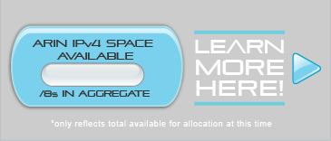
Current IPv4
Inventory
4.64
4.64 /8 equivalents in the pool of
“available addresses”
4.43 /16 equivalents in the “RRH” bucket
(RRH = returned, revoked, held)
1 /10 reserved
  For NRPM 4.10 “Dedicated IPv4 block to facilitate IPv6 Deployment”

Slide 4
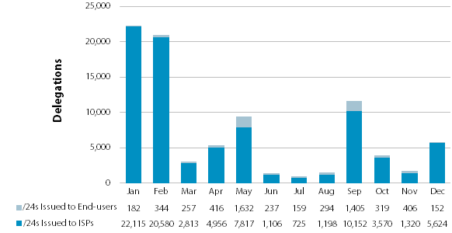
2011 & Q1 2012 IPv4 Allocations and Assignments Issued By ARIN
(listed in /24s)
**Feb 3 2011: IANA depletion and new 3-month allocation policy for ISPs implemented

Slide 5
2011 and Q1 IPv6 Address Allocations
and Assignments
**Feb 3, 2011- IANA depletion

Slide 6
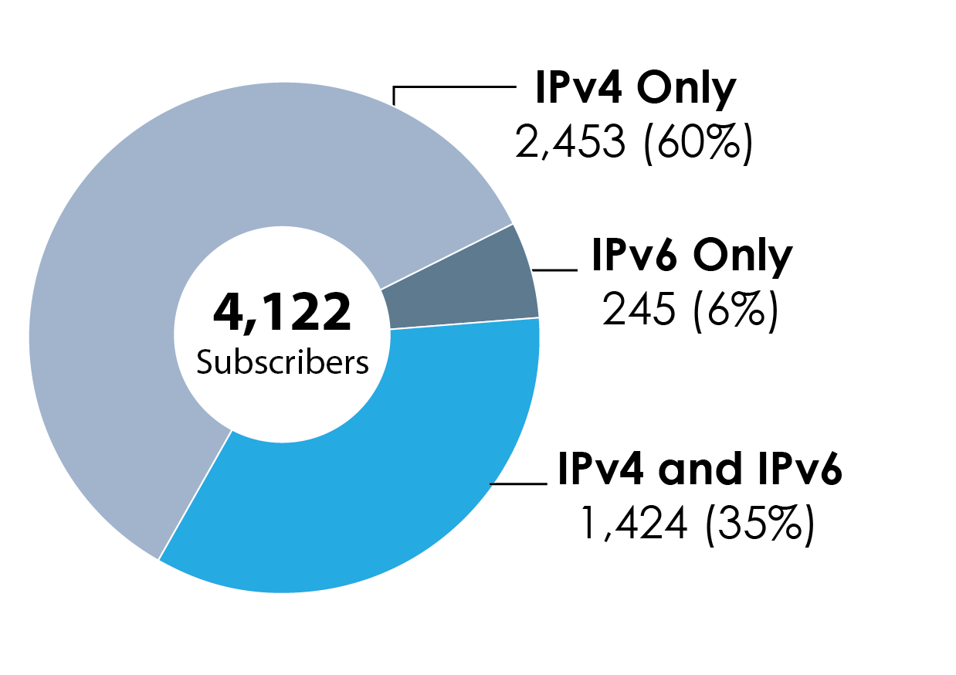
ISP Members with IPv4 and IPv6
Total of 4,122 ISP Subscriber Members
*as of Mar 31, 2012

Slide 7
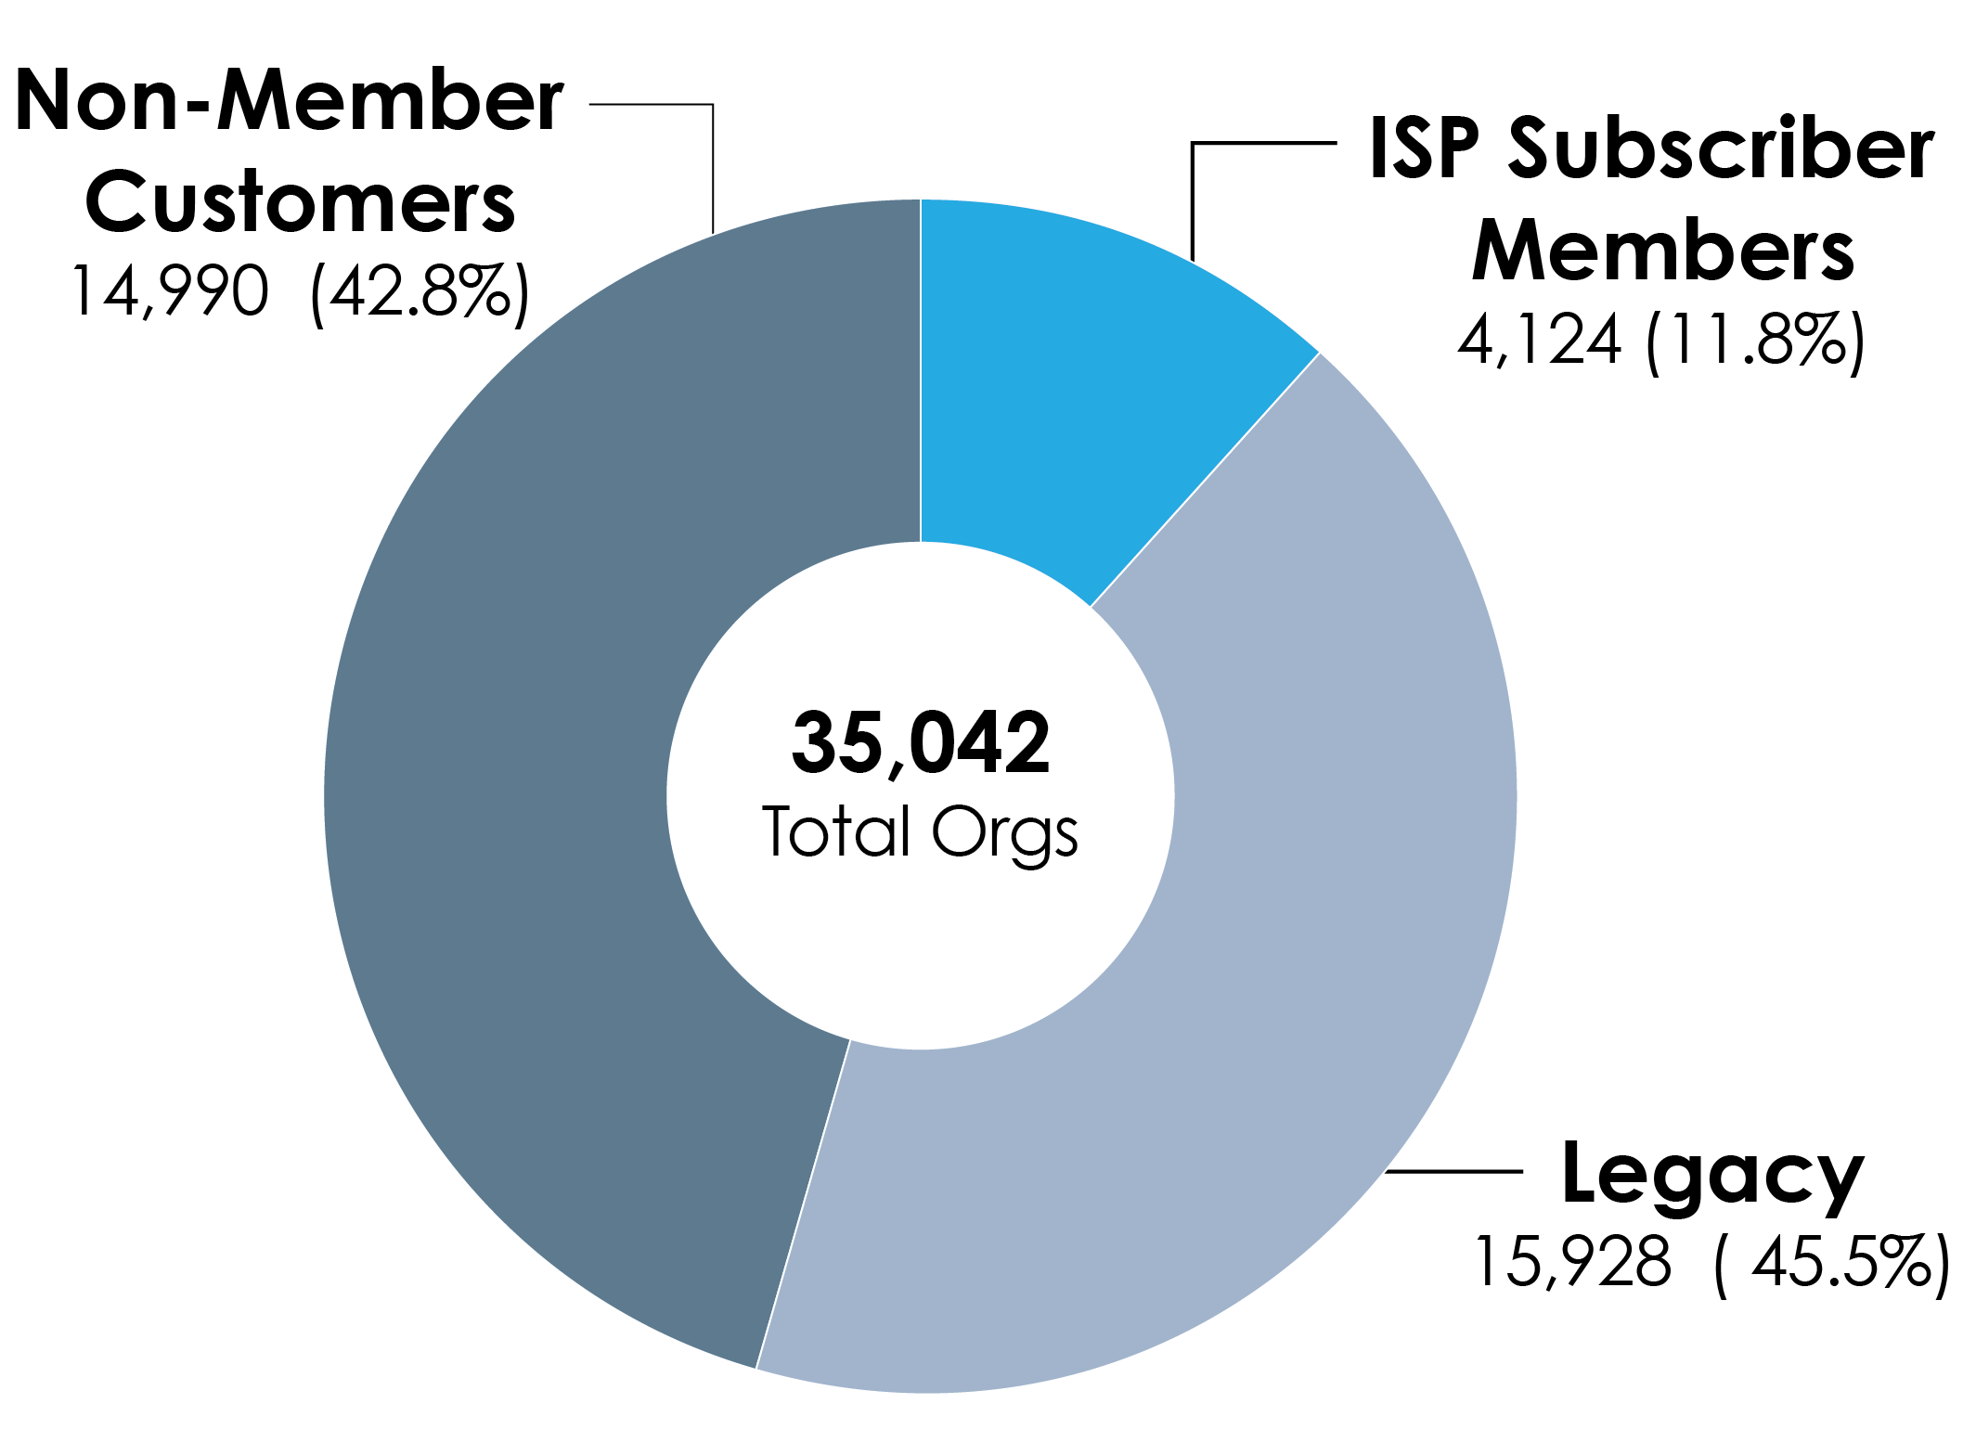
Total Organizations Served by ARIN
*as of Mar 31, 2012

Slide 8
IPv4 Transfer Stats
2011 & 1st Qtr 2012
*8.3 transfers are to Specified Recipients
*8.2 transfers are Mergers & Acquisitions

Slide 9
Specified Transfer Listing Service (STLS)
Voluntary listing service established to facilitate the transfer of IPv4 addresses under NRPM 8.3 “Transfers to Specified Recipients”
  “Lister”- *validated entity that has IPv4 space available for transfer
  “Seeker”- *validated entity that has a demonstrated need for IPv4 space and can pre-qualify under policy
  “Facilitator”- *validated entity that facilitates transfers between agreeing parties
*Org vetted, must agree to ToS

Slide 10
Draft Policies Moving Forward
ARIN-2011-1: ARIN Inter-RIR Transfers
  Would allow transfers to/from the ARIN region
  The two RIRs must have compatible transfer policy; transfer based on need
    AC recommended adoption
ARIN-2012-1: Clarifying requirements for IPv4 transfers
  Establishes criteria for 8.3 Specified Transfers and inter-RIR transfers
  Cannot have gotten space from ARIN in previous 12 months or get additional space for 12 months after transfer
    Last Call
ARIN-2012-3 ASN transfers
  Adds ASNs to specified transfers
    Last Call

Slide 11
Public Facing Development Efforts
ARIN Online
  Billing integration initiated
Implemented Whowas Service
  Subject to ToS
RPKI
  Running into HSM issues which are delaying rollout
    Hosted: To be completed in 2012 –development is underway
    Delegated: To be done after Hosted deployed

Slide 12

2012 Outreach Events
Events include:
  ARIN on the Road (New York, Chicago, and more)
  CES
  Internet2 Joint Techs
  V6 World Congress
  North American IPv6 Summit
  Interop
  The Cable Show
  CANTO

Slide 13

Upcoming ARIN Meetings
Spring 2013 – in progress

Slide 14


