Slide 1
APNIC Update
Louise Flynn, Marketing and Public Relations Consultant
April 2012

Slide 2
IPv4 Exhaustion
Defined 3-stage process
Stage 1: normal allocations
Stage 2: modified evaluation process
Stage 3: “Final /8” policy (rationing)
Stage 2
Strict serialisation of requests and responses
Collective evaluation by Hostmaster team
Ended on 15 April 2011
Approx 180 unfulfilled requests, no ongoing disputes
Stage 3
Maximum allocation now /22 per organisation (from 103/8)

Slide 3
Resource Delegations

Slide 4
IPv4 Exhaustion
APNIC reached its final /8 IPv4 block on 15 April 2011
Now delegating from the final /8 (103/8)
Maximum of a /22 per account holder
APNIC secretariat contacted by a few IPv4 brokers
Maintains neutrality and ensuring policy compliance
Considers pre-approvals and qualified broker listing service

Slide 5
Final /8 Delegations

Slide 6
IPv4 Transfers
Demonstrated need now required
prop-096 implemented November 2011
Except routine M&A transfers
Pre-approval requests
Can be sought prior to transfer
Request process identical to traditional IPv4 address request
Pre-approval when granted is valid for 1 year
Broker contract/agreement
Requires commitment to APNIC policies in all transactions
Contracted brokers will be listed and “recognised”
Inter-regional transfers
prop-095 implemented August 2011
Requires counterpart RIR with compatible policy

Slide 7
IPv4 Transfers

Slide 8
IPv4 Transfers
prop-096 implemented
prop-050 implemented

Slide 9
Resource Quality Assurance
Reachability testing
Applied to /8s received from IANA
E.g. 1/8
Whois cleanup project
155,618 unreferenced objects removed
49,542 errors fixed
Campaign to update mnt-irt object attributes
Outreach activities
APNIC meetings and NOGs
http://meetings.apnic.net/33/program/bof

Slide 10
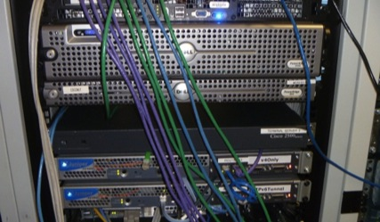
Learning and Development
New Area established 2011
Directed by Dr Philip Smith (you know him)
Increased focus on IPv6
eLearning (WebEx)
One-hour “live” training sessions
Delivered fortnightly to three time zones
Training lab
For online, remote access during training
Equipped with IPv6, 4-byte AS Numbers
ISP-like topology with multiple operating regions
Hands-on environment with core, edge, and access networks

Slide 11
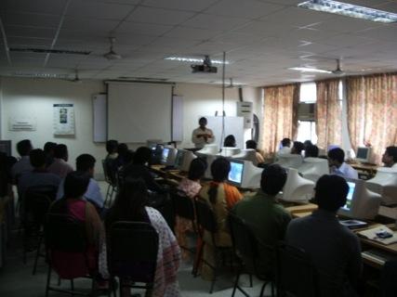
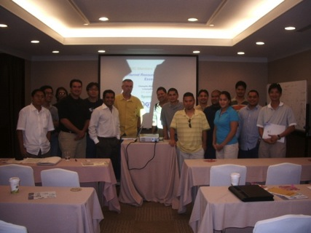
2011 Training Statistics
Face-to-Face
67 courses in 36 locations
1,813 total participants
eLearning
76 courses
786 total participants
IPv6 courses
27 locations in 20 economies
1,147 total participants

Slide 12
APNIC Labs
IPv6 Capability measurement
Google ad data collection (thanks to Google)
Code snippet enables website-specific measurements
600,000+ measurements per day
Analysis by source economy, ASN, and more
IPv4 address report
IPv4 free pool address exhaustion
http://labs.apnic.net
http://blabs.apnic.net

Slide 13
IPv6 Program
Regional events and activities
Pacific Telecommunications Council (PTC), Hawaii, January 2011
Philippines IPv6 Conference, Manila, January 2011
IPv6 Transition conference, APRICOT 2011, Hong Kong
Seminar for DNS community, ICANN 41, Singapore
China IPv6 Summit, Beijing, April 2011
ITU/APNIC IPv6 Workshop, Bangkok, July 2011
World IPv6 Day, 8 June 2011
IPv6 Transition Plenary, APNIC 32, Busan
Asia Pacific Top Level Domain (APTLD), Busan, September 2011
Australia IPv6 Summit, Melbourne, Octber 2011
China Mobile MIRACLE 2011, Beijing, November 2011
Singapore iDA IPv6 Executive Briefing, Singapore, November 2011
Taiwan IPv6 Summit, Taipei, November 2011
APIPv6 Task Force
APNIC providing Secretariat services
Notes:
Pick biggest events and add context info

Slide 14
IPv6 Program
Regional events and activities
IPv6 Transition Plenary, APNIC 32, Busan
Asia Pacific Top Level Domain (APTLD), Busan, September 2011
Australia IPv6 Summit, Melbourne, Octber 2011
China Mobile MIRACLE 2011, Beijing, November 2011
Singapore iDA IPv6 Executive Briefing, Singapore, November 2011
Taiwan IPv6 Summit, Taipei, November 2011
Work with regulators, policymakers, and government
IPv6 technical and policy issues
IPv6 deployment capacity building in dev economies
APECTel 44
APIPv6 Task Force
APNIC providing Secretariat services
Notes:
Pick biggest events and add context notes

Slide 15
Internet Governance Forum
IGF 6
2011 in Nairobi, Kenya
Sponsored one remote hub - University of the South Pacific, Fiji
Total of 18 participants
Regional IGF events
Inaugural Pacific IGF (PacIGF), New Caledonia
Asia Pacific Regional IGF (APrIGF), Singapore
APrIGF 2012, Japan, July 2012
Multi-stakeholder Advisory Group (MAG)
Paul Wilson serving from May 2012
with Paul Rendek (RIPE NCC) and Raul Echeberria (LACNIC)

Slide 16
Information Society Innovation Fund
ISIF is now part of the Seed Alliance
Alliance for Internet development and digital innovation
Joint effort with LACNIC and AfriNIC
Ongoing support by IDRC (CAD $1.3m)
New round launching soon
http://www.isif.asia
Notes:
ISIF is a grants program aimed at stimulating creative solutions to ICT development needs in the Asia Pacific region
Since 2009, ISIF has supported 23 initiatives in 12 AP economies through grants and awards
In 2011:
47 nominations from across the region
4 winning projects presented during Nairobi IGF

Slide 17
2012 Survey
Focus groups
Held during April 2012
17 face-to-face meetings in 13 economies
Content to be reflected in the final survey report
Online survey form
APNIC Members, regional, and global stakeholders
Questions specific to stakeholder groups
Launch: May 2012
Results
Due in August 2012 (APNIC 34, Phnom Penh)
Feeding directly into planning for 2013
www.apnic.net/survey

Slide 18
Coming up …
APNIC 34, Phnom Penh, Cambodia
21-31 August 2012
New: Workshop week!
#APNIC34
APNIC 35, Singapore
20 February - 1 March 2013 (with APRICOT 2013)
http://www.apnic.net/meetings
Notes:
Cambodia Banner

Slide 19
Connect with APNIC
Follow @apnic
Join APNIC Page

Slide 20
Thanks
Louise Flynn
lou@apnic.net

