Slide 1

Egypt IPv6 Task Force; Progress, Challenges and Future Trends
Nezar Nabil Sami
nsami@nileuniversity.edu.eg
AfriNIC-10

Slide 2

Agenda
Global vs. Local Trends
IPv6 Task Force Progress
The Leap Frog!!

Slide 3

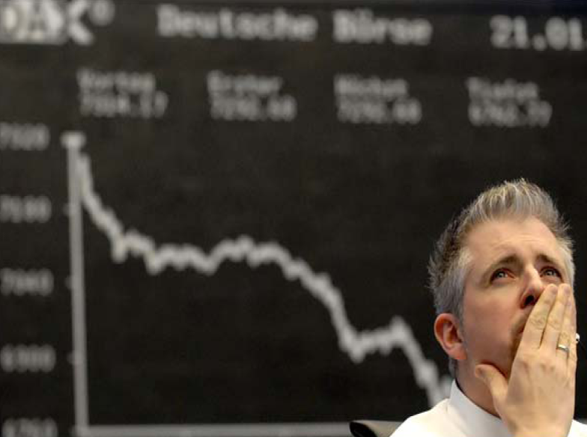
Global vs. Local Trends

Slide 4
Global Trends
Internet users grew 183% from 2000.
1 billion users last year. 2 billion by 2011.
2 billion cell phones in 2006. 3 billion by 2009.
Wireless “hotspots” grew 87% in one year. Now 100,000. 200,000 by 2010.

Slide 5


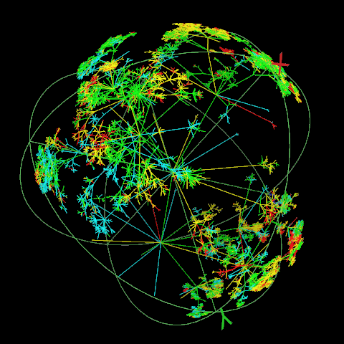


Power Trend
Global Connected Economy
Financial
Crisis
Internet
Complexity and Challenge!
Commoditization of Technology

Slide 6
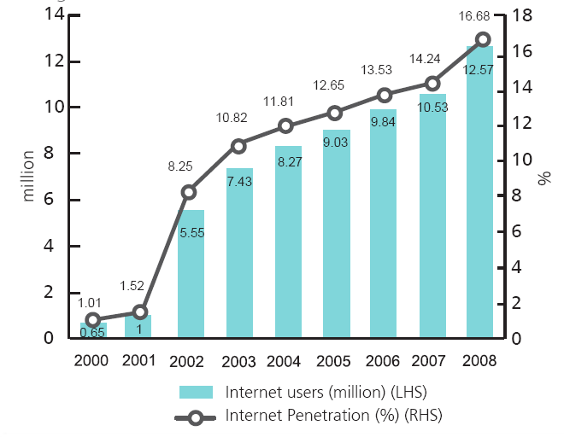
Egypt:
Internet Users & Internet Penetration

Slide 7
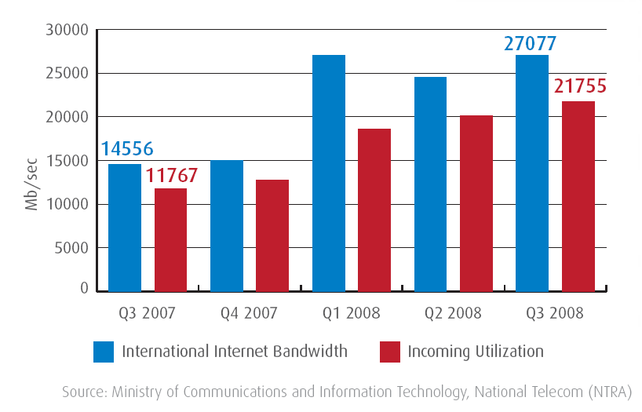
Egypt:
International Internet Bandwidth

Slide 8
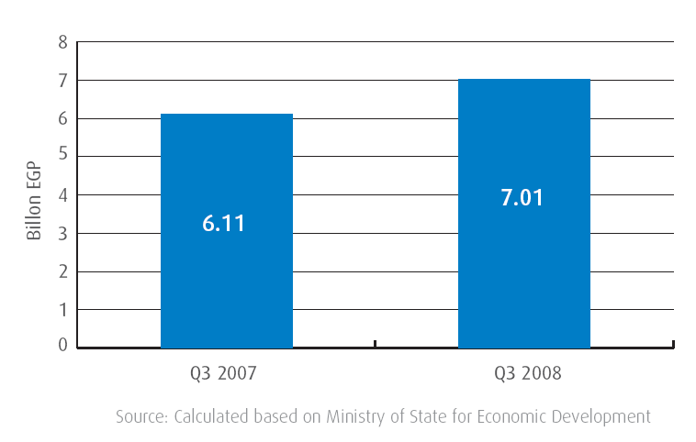
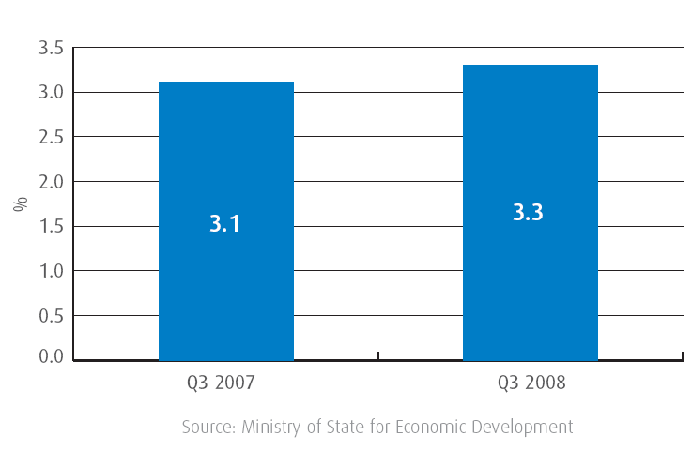
Egypt:
ICT Contribution in GDP

Slide 9
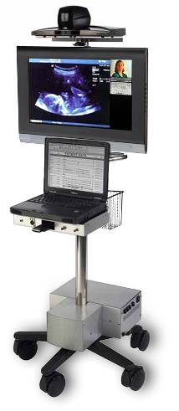


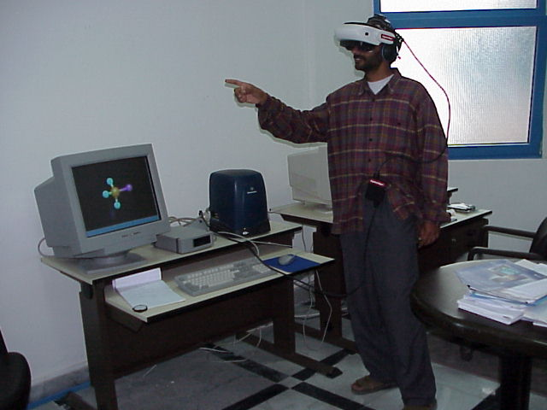
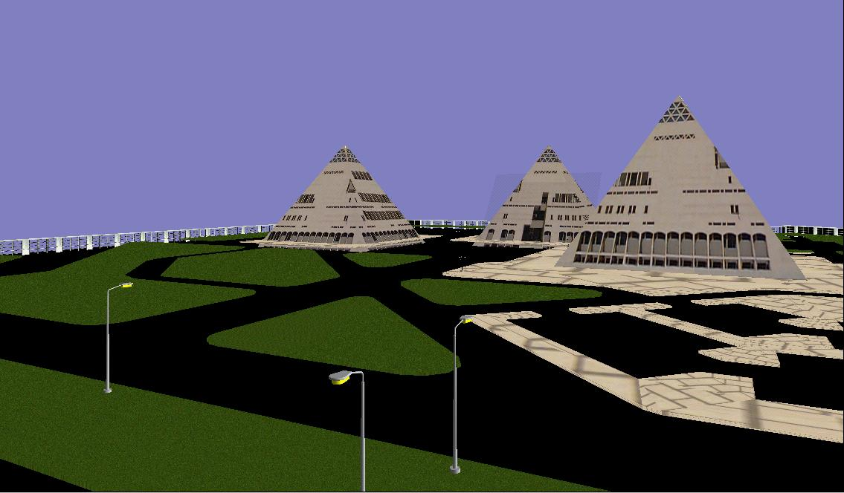
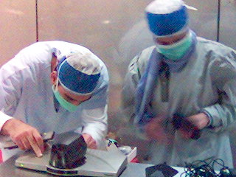

Slide 10
Why care about Green?
Power Consumption Forecast [B kWh]
(2006-2025)
Electricity costs rose 88% in US since 2003 (source: US EIA official government stats)
Energy is a non-trivial OPEX item
Worldwide legislation changes and public support for energy efficiency and climate control
  California:
  reduce CO₂ by 80 % in 2050
  European Union:
  reduce CO₂ by 20% by 2020
  UK:
  reduce CO₂ by 20% by 2010
  Japan:
  reduce CO₂ to 6% below 1990 level by 2010
Source: IDC 2007
10.3
Network Equip
Display/TV
8.2
Servers
5.3
2.1
1.6
0.8
PC
0.4
0.2
2006
2025

Slide 11

IPv6 Task Force Progress

Slide 12
E-IPv6 Test Bed
1
Build many test labs with native IPv6 & connect them together by using IPv6 over IPv4 Tunnels
2
Connecting IPv6 test labs via dedicated leased lines. (Native IPv6 Connectivity)
3
Building the Egyptian native IPv6 backbone network (NREN)

Slide 13

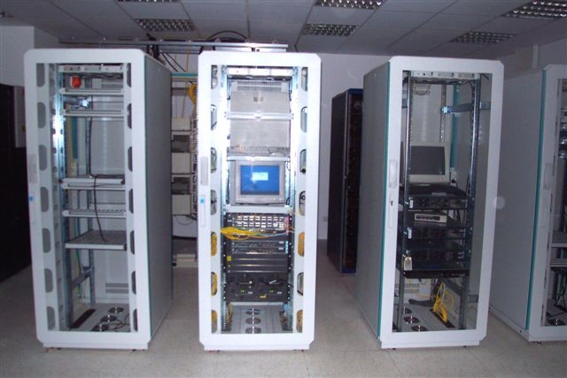
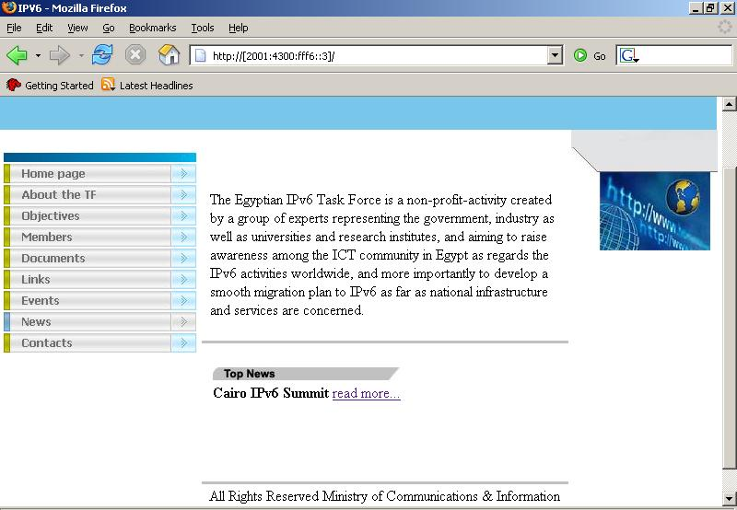
IPv6 Test Lab
http://www.ipv6tf.org.eg

Slide 14



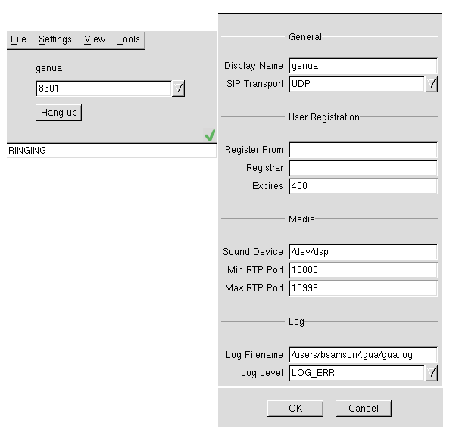
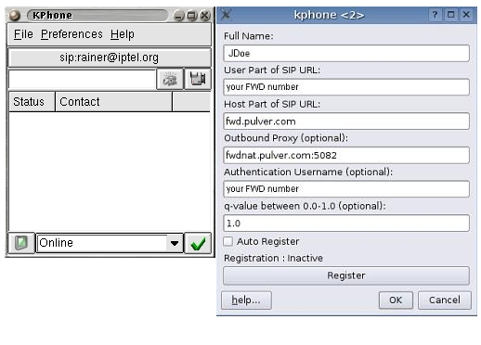

VoIPv6
NREN
Network 1
Network 2
Asterix-v6
Server
SipSet Client
Kphone Client

Slide 15





ENSTINET NOC
Internet
Bandwidth
34 Mbps
EUN NOC
Bandwidth
155Mbps
Core Router
Operating Bandwidth
155Mbps
LINKdotNET
Gateway
Fiber Cable Connection
34Mbps
34Mbps
34Mbps
34Mbps
Provider Edge
Router
155Mbps
34Mbps to Telecom Egypt
LINKdotNET
(MPLS-based Network IPv4/v6 Operation)
34Mbps to Telecom Egypt
PoP
PoP
PoP
PoP
Fiber Cable Connection
Operating Bandwidth
34Mbps (up to 1Gbps)
Access Router
University
Research
Center
MCIT
Access Router
GUC
AUC
BibAlex

Slide 16

The Leap Frog!!

Slide 17
Collaborative Work
Content Delivery
  Egyptian R&E Repository
Medical Applications
  Telemedicine (Tele-surgery, Tele-radiology, Tele-pathology ..etc)
High Speed Computing
  Grid Computing and applications
Applied Sciences
  Genetics Engineering
  Biotechnology Applications
  Nanotechnology Applications
Renewable & Sustainable Energy
Remote Sensing & Space Sciences
Astronomy & Geophysics (Solar Research, Seismology, Geomagnetism ..etc)
Digital Library & Interlibrary Loan
Virtual R&E Community

Slide 18


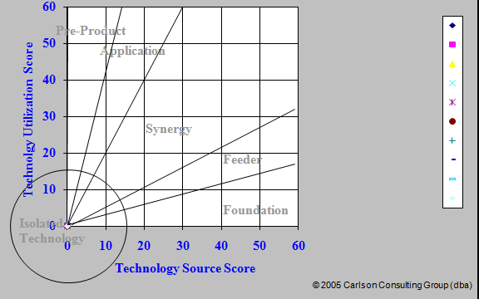


IPv6 Investment

Slide 19

Thank You..
Nezar Nabil Sami
nsami@nileuniversity.edu.eg

